Slide 1

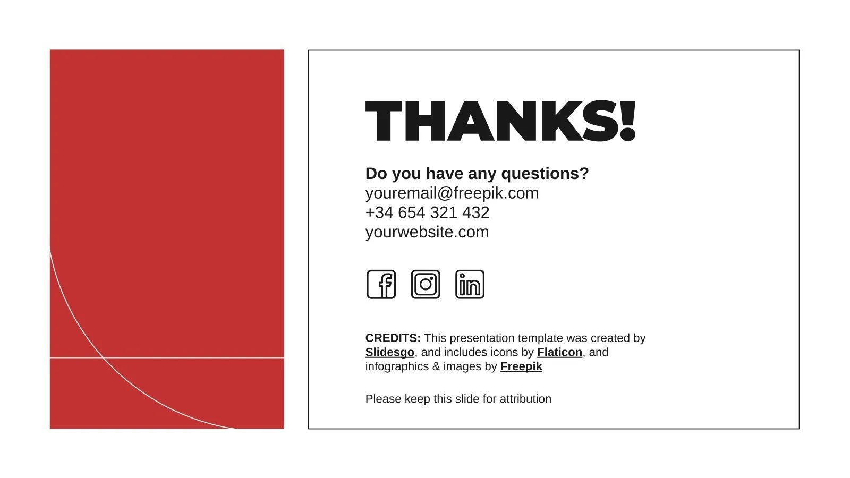
Content | Slide
Churner Demographics | 1
Churner Services | 2
Reasons for Staying | 3
Reasons for Churning | 4
Mailers and Incentives | 5
Santa
Tech
Because We Deliver
An Information Deck Analysing Swan Teleco Customer Retention Data
By: Frankie, Otis, Toby, Vivien

Slide 2
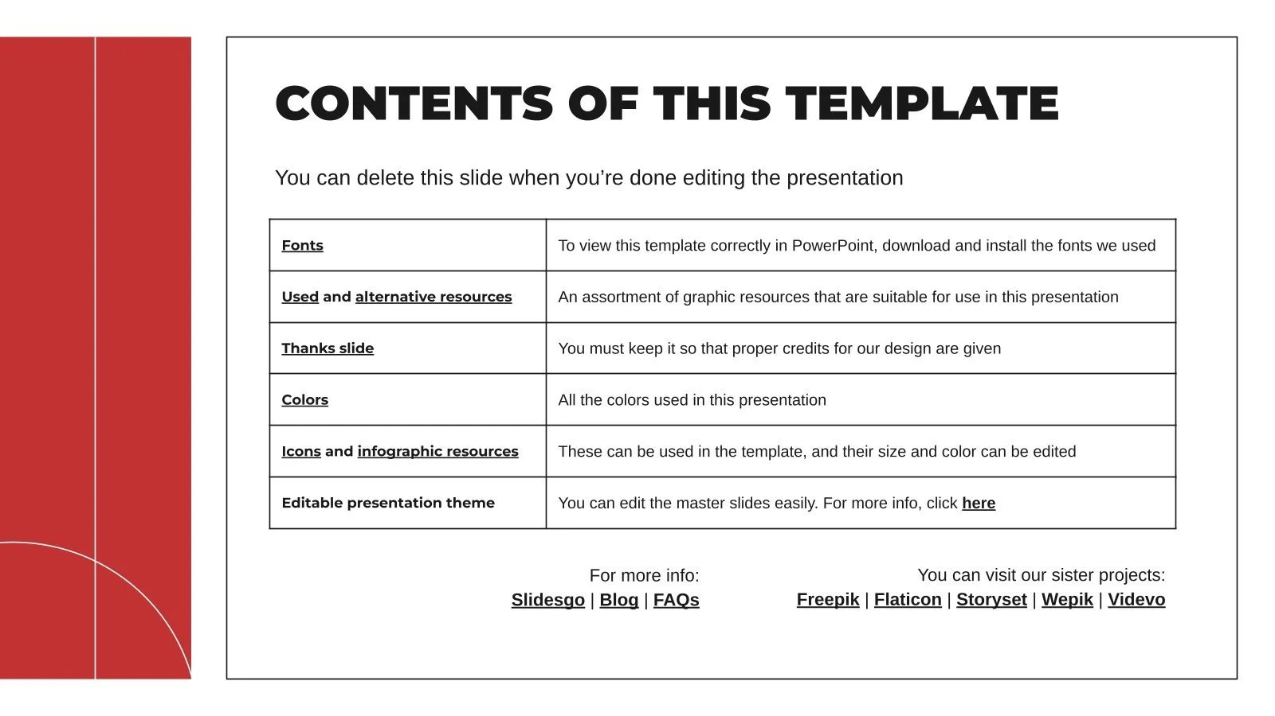
What Do Churners Look Like?
A table comparing the demographics of churners to non-churners
Demographics | Are Male | Are a Senior Citizen | Are Single | Have No Dependents
Churners | 50% | 25% | 64% | 92%
Non-Churners | 50% | 15% | 47% | 71%
Difference | 0% | 10% | 17% | 21%
Senior customers may find trouble navigating some of the services. Additionally, downsizing, or relocating to a senior home will prompt churning
Customers are more likely to churn if they are senior citizens, single, and have no dependents.
Why?
Customers considered to be settled down (i.e have partners and have dependents) might be less likely to churn because they tend to seek stability, making them relocate infrequently, prioritising a single strong plan for their families.

Slide 3
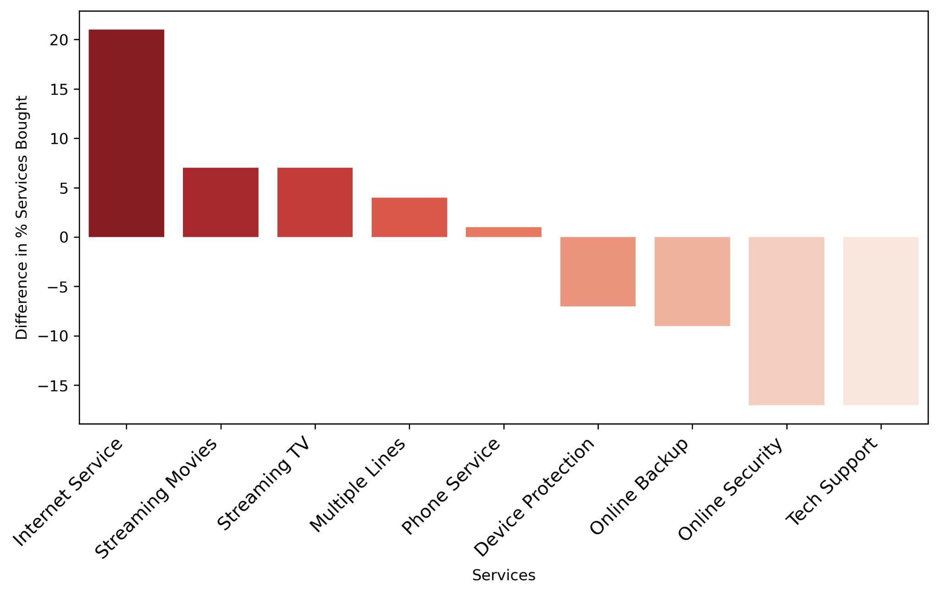
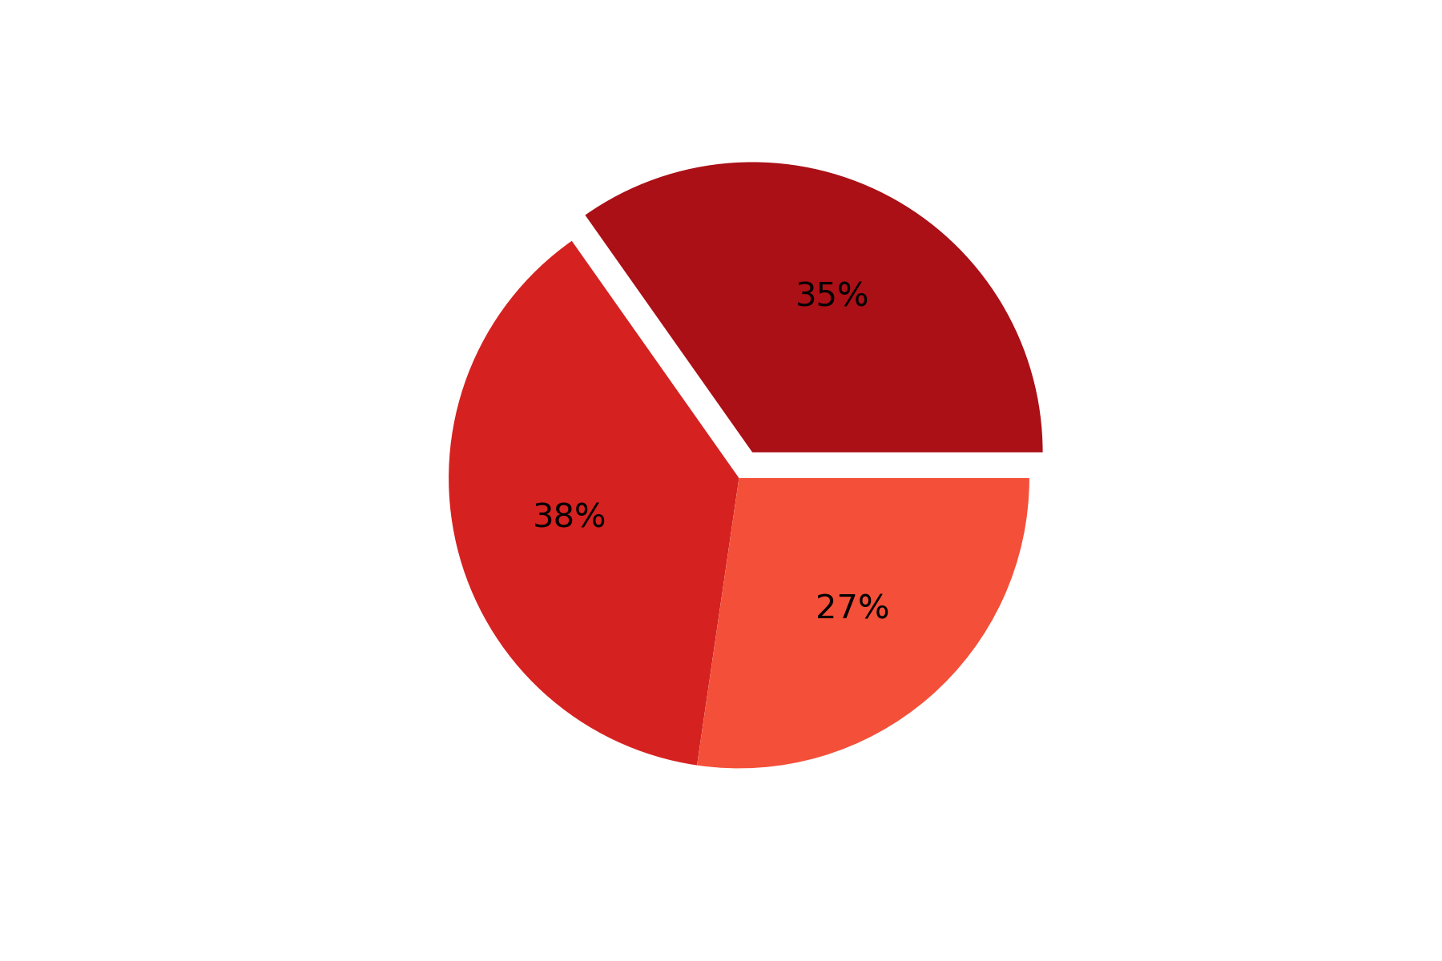
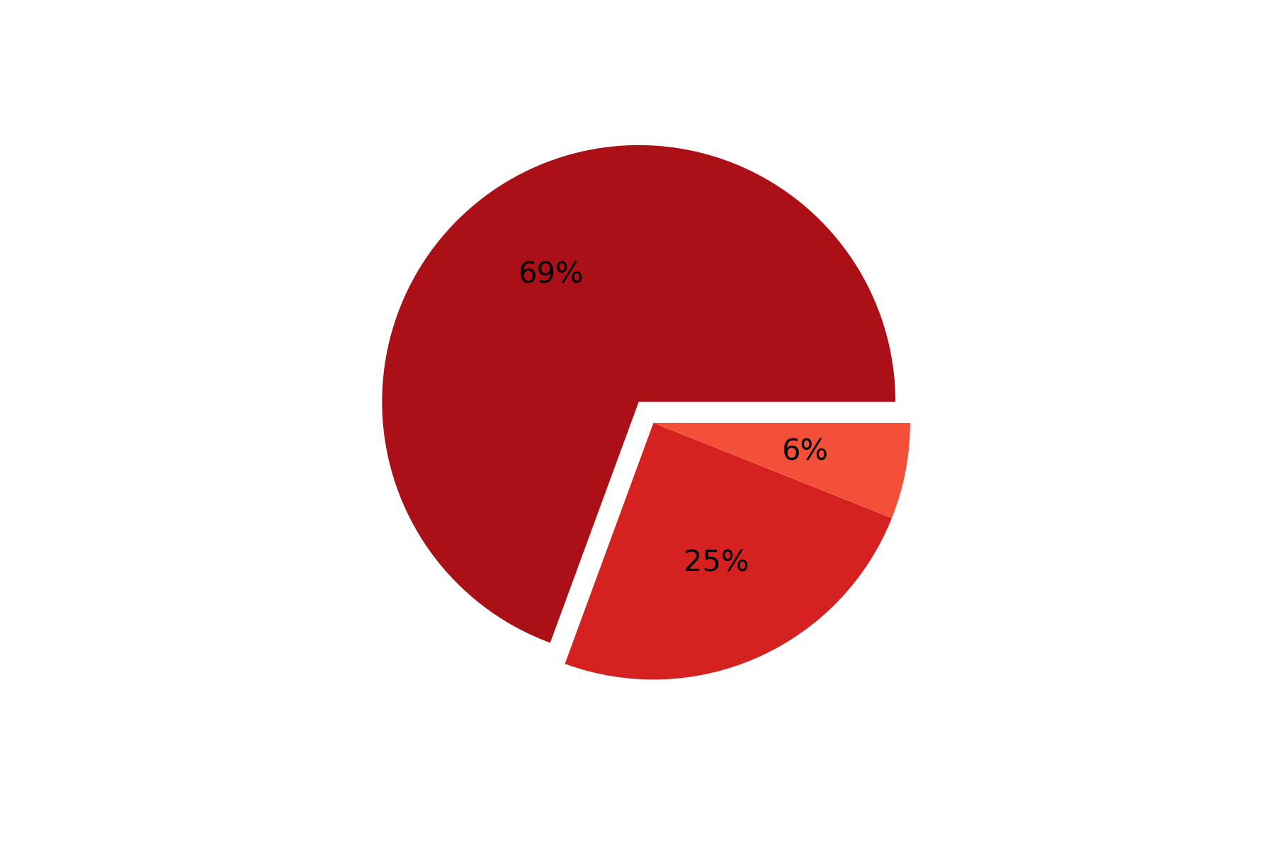
What Services Did Churners Have?
A bar plot comparing the % difference between customers that have churned/not churned against each service
Internet Services
Churned
Non-Churned
Customers are 21% more likely to churn having Internet Services.
Fiber Optic
DSL
No Internet
Customers are 17% less likely to churn having both online security and tech support, and 9% and 7% less likely to churn having online backup and device protection respectively
Interestingly, Customers are 34% more likely to churn having fiber optic internet, but 13% less likely to churn having DSL internet

Slide 4
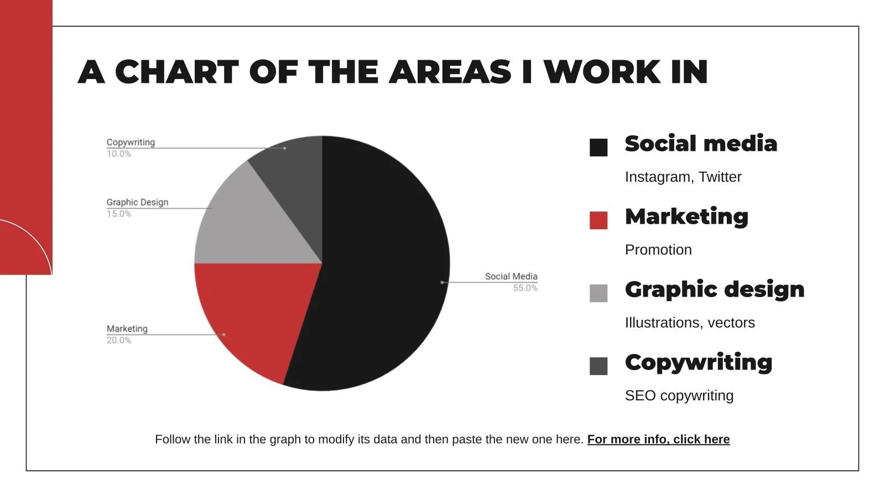
What Services Make A Customer More Likely To Stay
A table comparing the previously identified factors contributing to a customers likelihood of churning/staying
What do we notice about the stay factors against the churn factors?
Stay Factors | Churn Factors
Tech Support Online Security Online Backup Device Protection | Internet Service Streaming Movies Streaming TV Multiple Lines Phone Service
The stay factors are all services that improve customer experience, safety, and security
The churn factors are services that actively provide a product
What could be some reasons for this?
Customers value a company that is able to guarantee protection of their data
Customers are less likely to switch if their data is already secure and protected in one location
Customers are likely to stay loyal to a company that has supported them first hand
Customers value performance, so will switch their plans in search of the best performance/speed

Slide 5
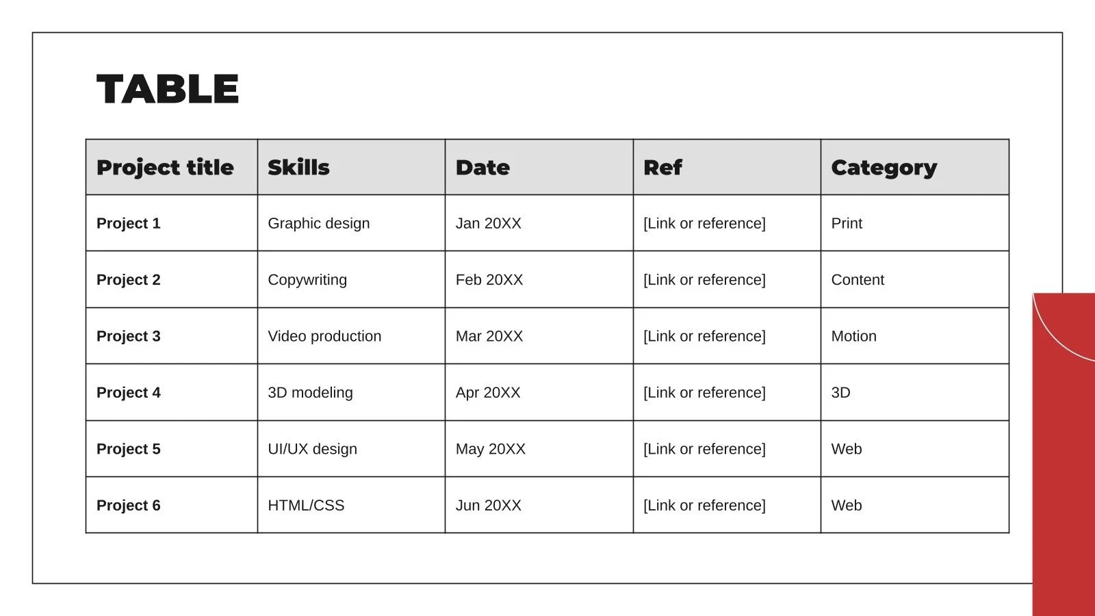

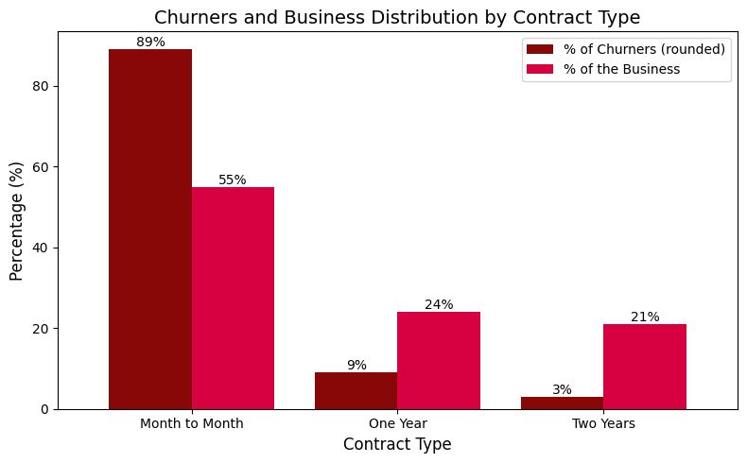
What Causes A Customer To Churn
Attitude of support person
Competitor offered higher download speeds
Competitor offered more data
Attitude of support person could be technical and contractual difficulties:
90% had month to month contracts
74% had paperless billing
85% had not got the technical support package
Competitor offered higher download speeds:
96% of people had internet service
Competitor offered more data:
90% held a phone contract
29% of all churners
What contract do churners have?
89% of churners have month to month contract despite the fact that only 55% of all contracts are month to month
Meaning that customers on one or two year contracts are significantly less likely to churn
How can we get more customers on these contracts?
The Incentivised sign-up factor!
Offering the new customer team the $2.50 every time they sign up a new customer on either a one year or two year contract

Slide 6
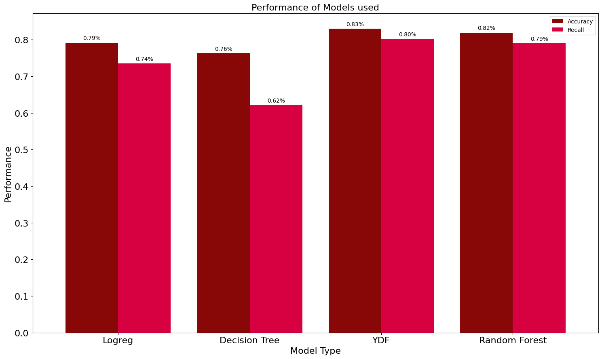
Determining The 500 Most Likely Churners
There are several models we employed in order to predict customer churn risk:
Logistic Regression
Decision Trees
Yggdrasil Decision Forests
Random Forests
When evaluating the performance of the models we used:
Accuracy: The percentage of overall correctness for predicting churners/non-churners
Recall: The percentage of just churners predicted correctly
Decision trees were unable to produce a model performing to the standard of the others, so, we excluded it.
We then calculated the average probability for each customer to churn using accuracy as a weight for each model.
Producing a list for the predicted churn risk of every current customer. From which, we can extract the top 500
In the future, we would consider employing the monthly charges to weight the top 500 customers

Slide 7

Thank you
If you have any questions reach us at:
santatech@northpolemail.com

